Slide 1
Team: Five Sigma
1. High frequency momentum trading
2. Time series analysis
3. Crypto fund competition and selection

Slide 2
Description
Cryptocurrencies
Traditional fiat currencies
highly volatile*
High frequency momentum trading strategies
quick profit

Slide 3
Data Collection

Slide 4
Select Data
Market cap
CryptoCompare Python API
hourly prices of 7 of the largest cryptocurrencies versus the US Dollar over three chosen starting dates until 14:00 on April 30th 2020.
2019-10-30 00:00 (6 months)
2019-04-30 00:00 (1 year)
2018-04-30 00:00 (2 years)
Select different time range 'TR' to see visualization and results accordingly.

Slide 5
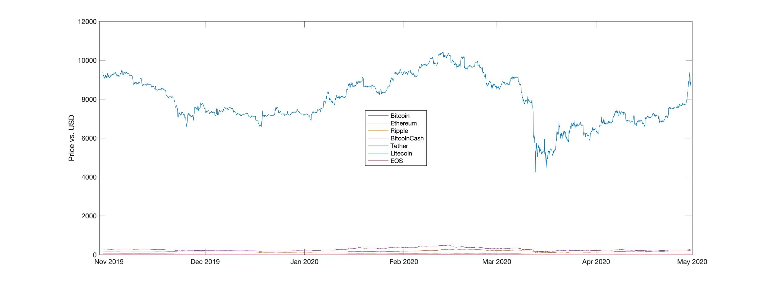
Data Exploration
Image 1: prices of 7 cryptocurrencies versus the US Dollar

Slide 6
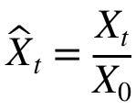
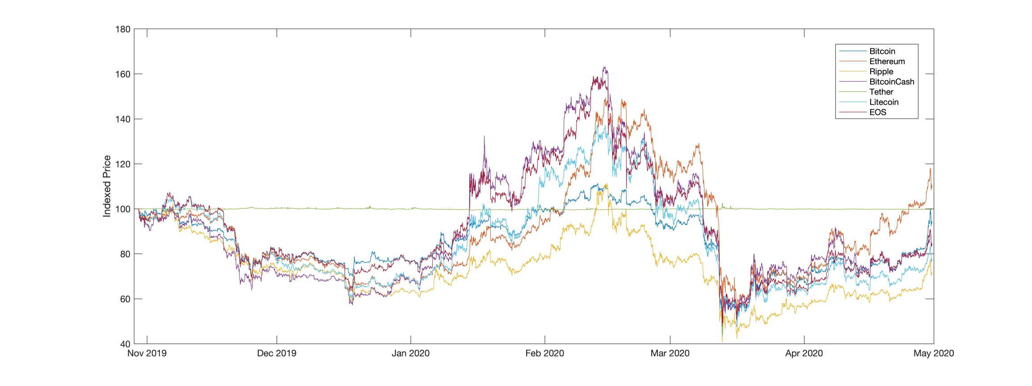
Index Price
better capture the volatility across cryptocurrencies
use it to build our signal.
Calculation formula:
Tether is a stable coin.

Slide 7
Method

Slide 8
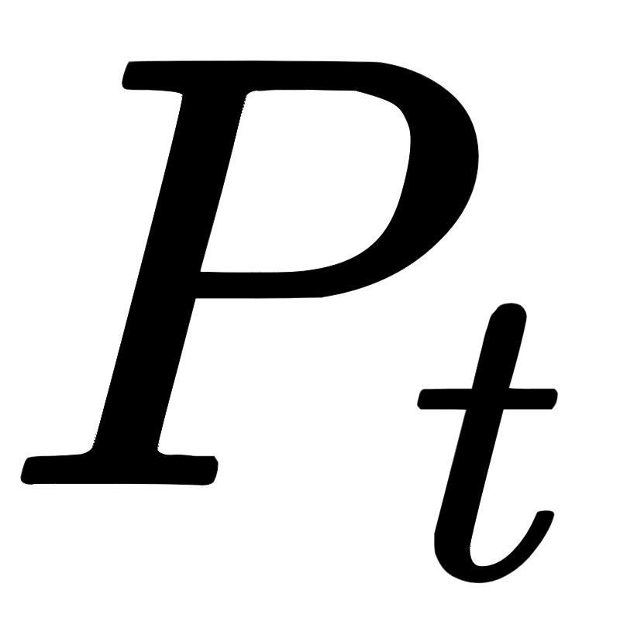
Rolling window approach
is the indexed exchange rate of a cryptocurrency at time t
the exponential smoothing ratio.
\alpha: constant weighting factor
short bursts of upwards or downwards movements over the course of a few hours
an EMA can capture this shorter term influence.

Slide 9
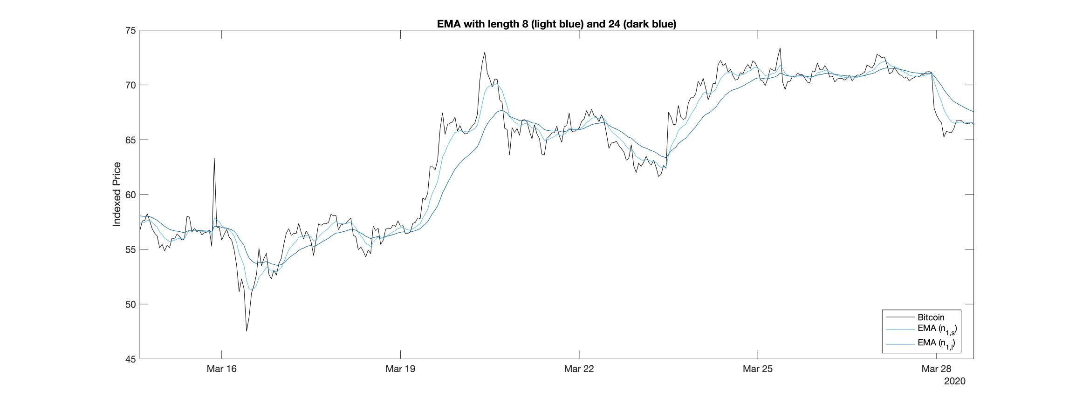
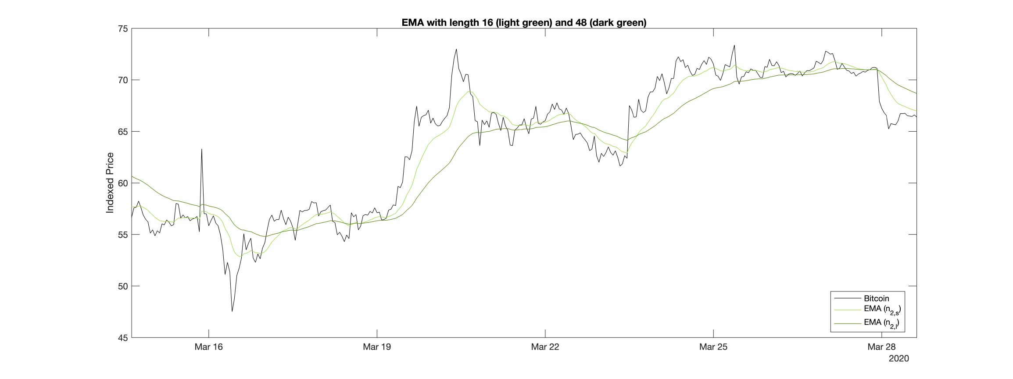
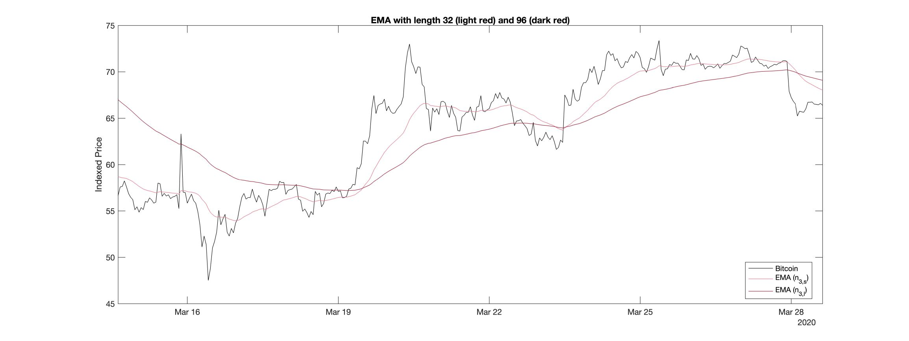
Exponential Moving Average
Image 3: EMA with length 8 (light blue) and 24 (dark blue)
Image 4: EMA with length 16 (light green) and 48 (dark green)
Image 5: EMA with length 32 (light red) and 96 (dark red)

Slide 10
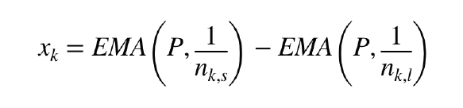

Base Signal for Momentum Strategy
Its sign determines whether one goes long or short in this currency.
The values of is:
positive: positive trend
negative: negative trend
equal to zero: the two EMAs intersect, trend changes direction

Slide 11
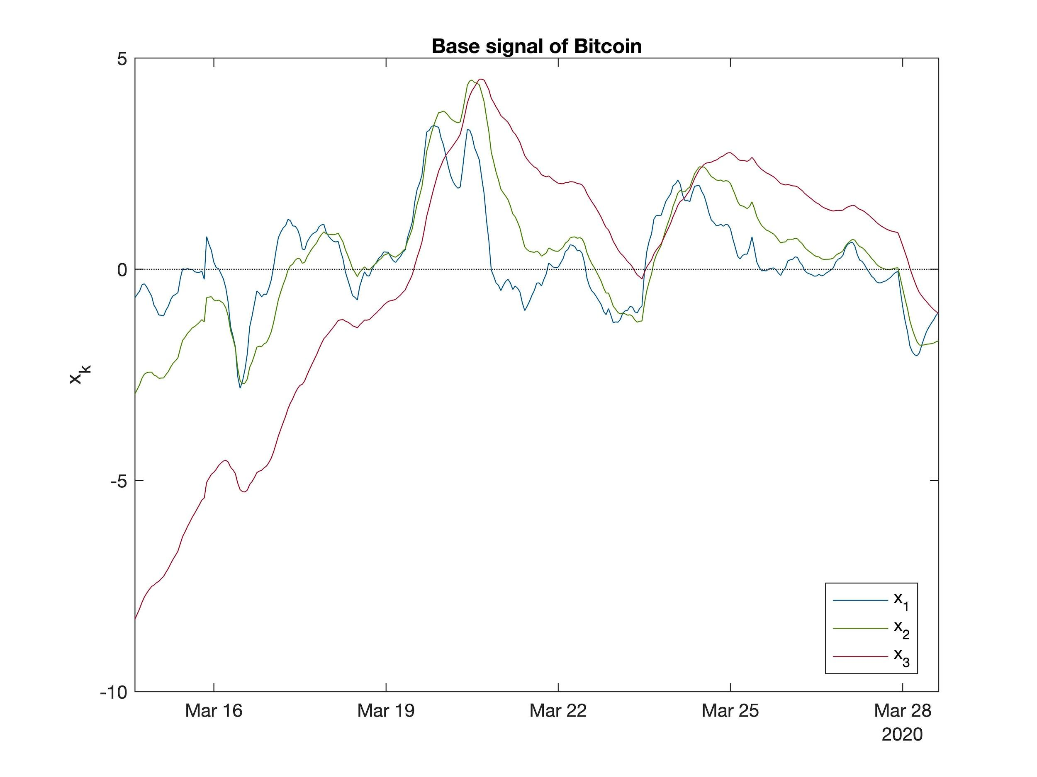
Base Signal for Momentum Strategy
Image 6: Base singal of Bitcoin

Slide 12
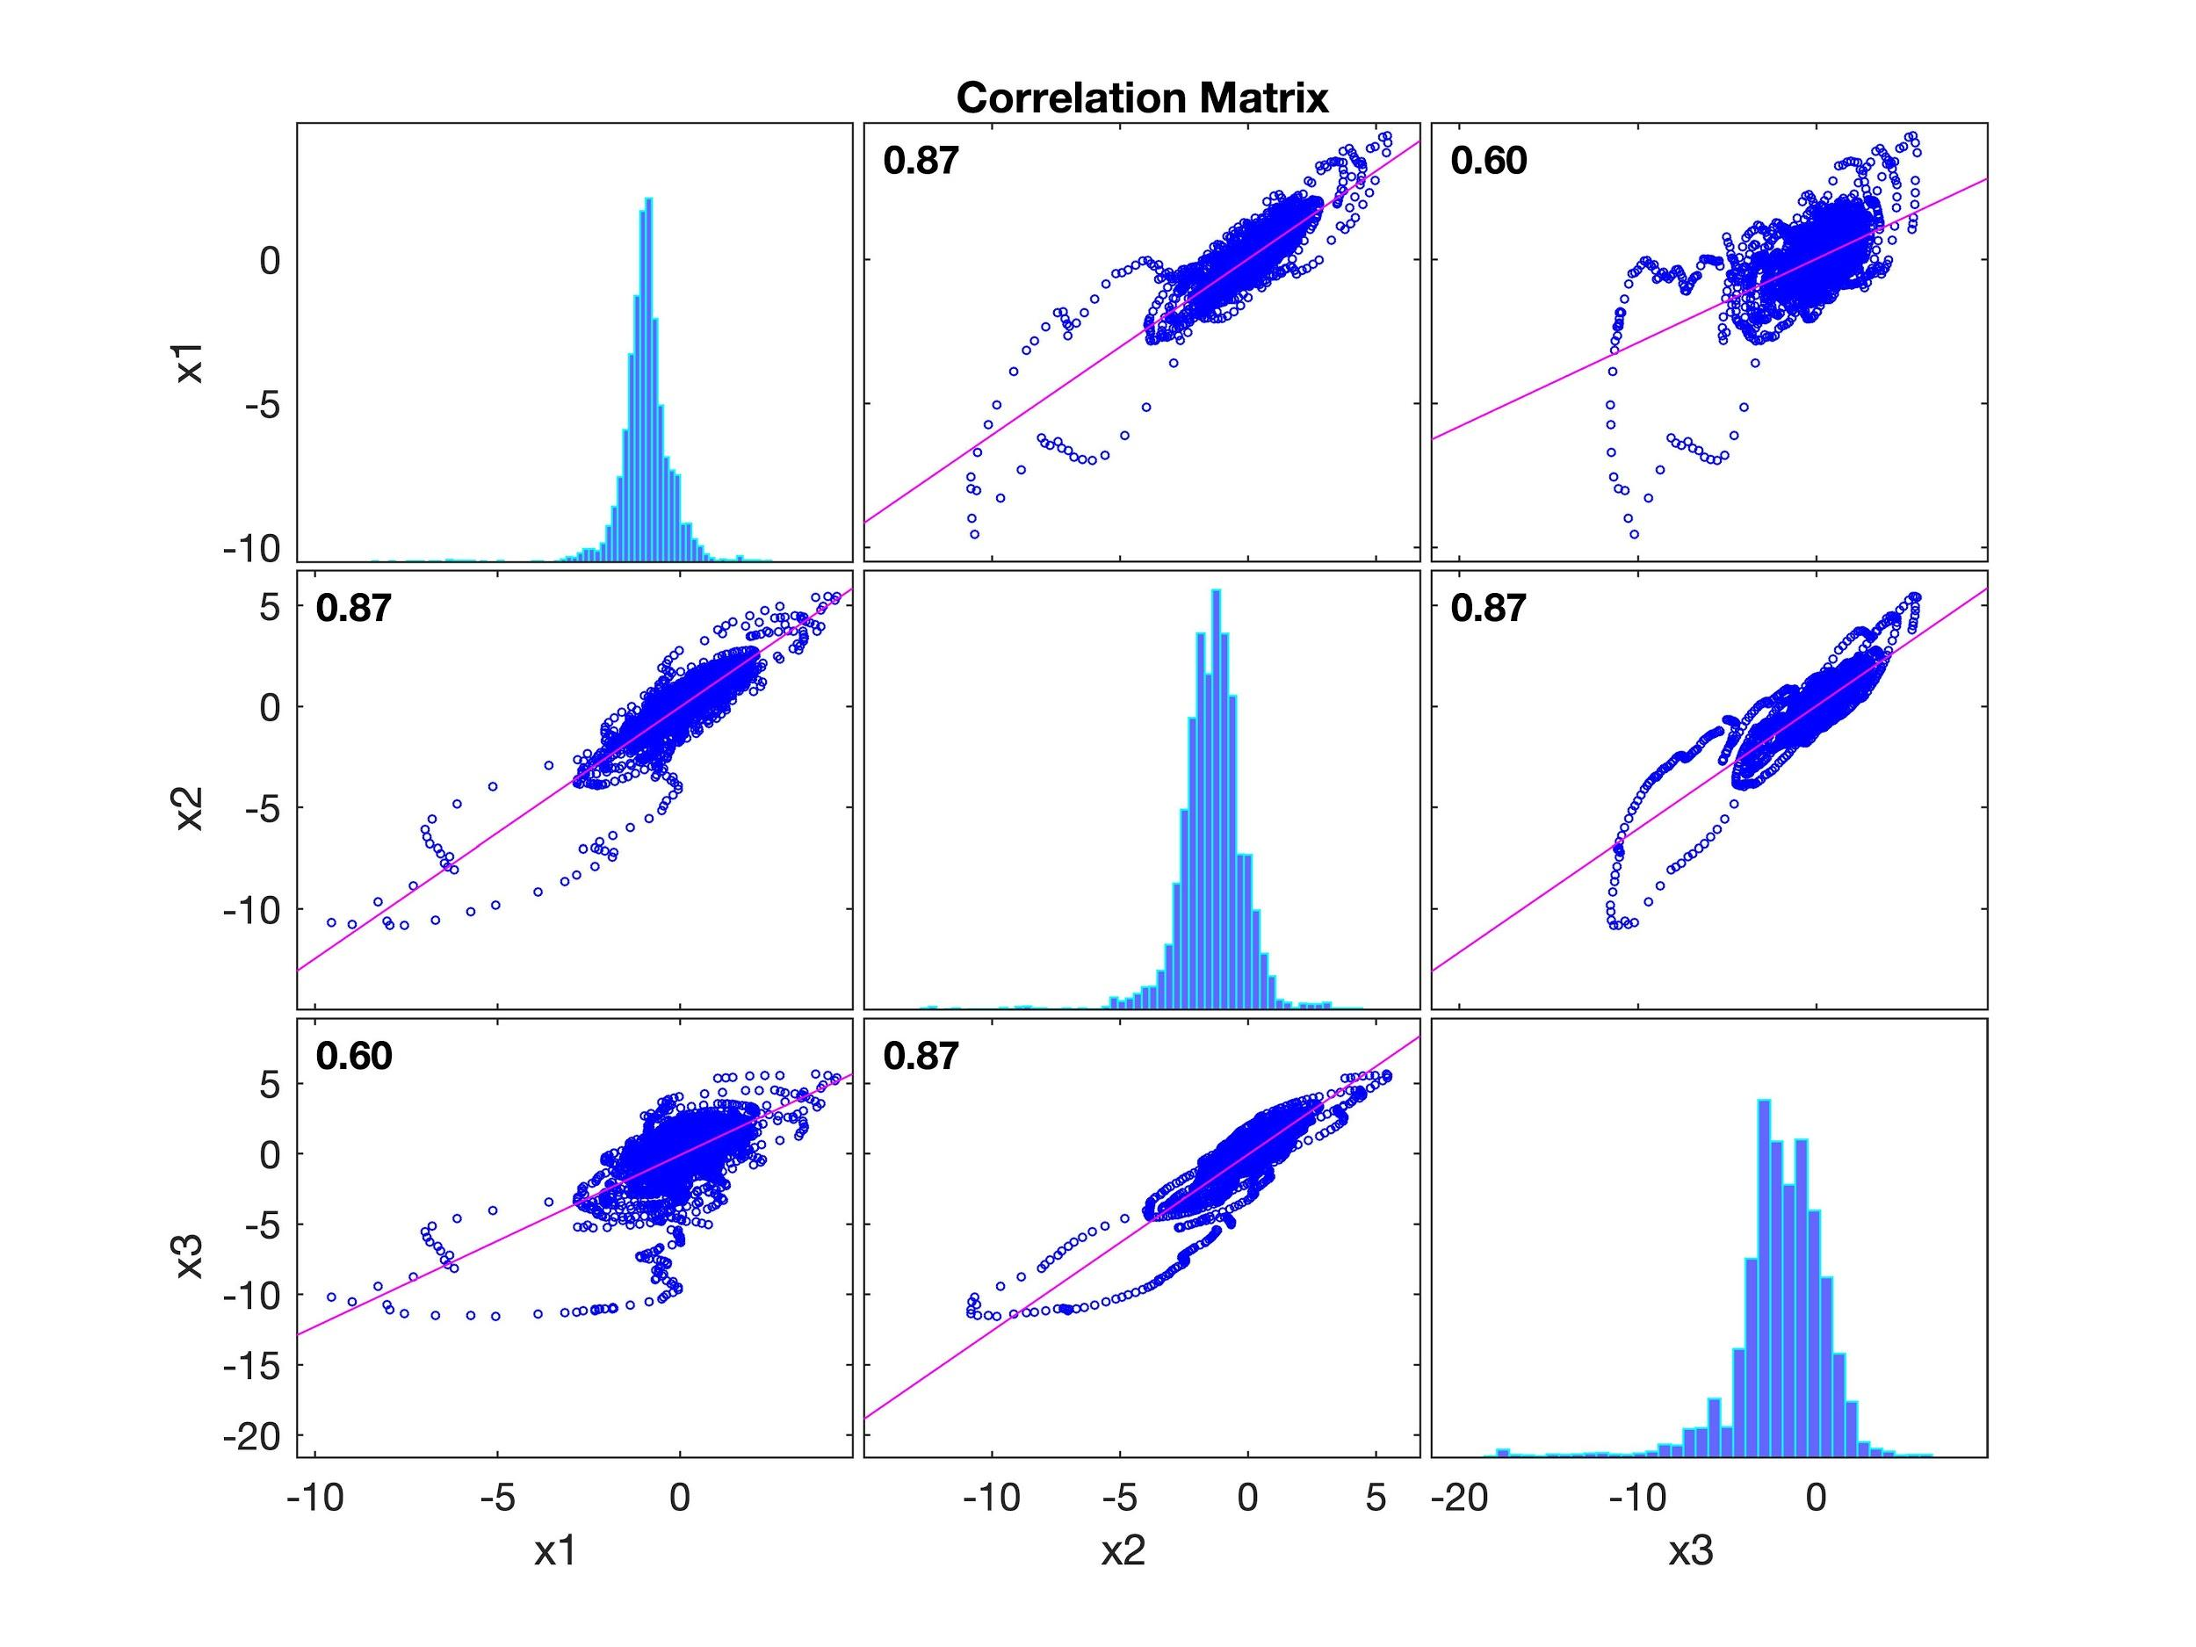
Base Signal for Momentum Strategy
Reducing the correlation leads to a longer time window, and vice versa.
Image 7: Correlation Matrix

Slide 13
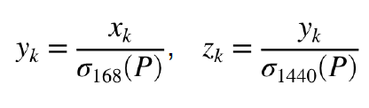
Two-step Normalization
We use time frames of 168 h or one week (short) rolling standard deviations, and 1440 h or two month (long) rolling standard deviations with a 20% hold-out.
The first transformation lowers high volatility and amplifies low volatility. The second's effect is similar.

Slide 14
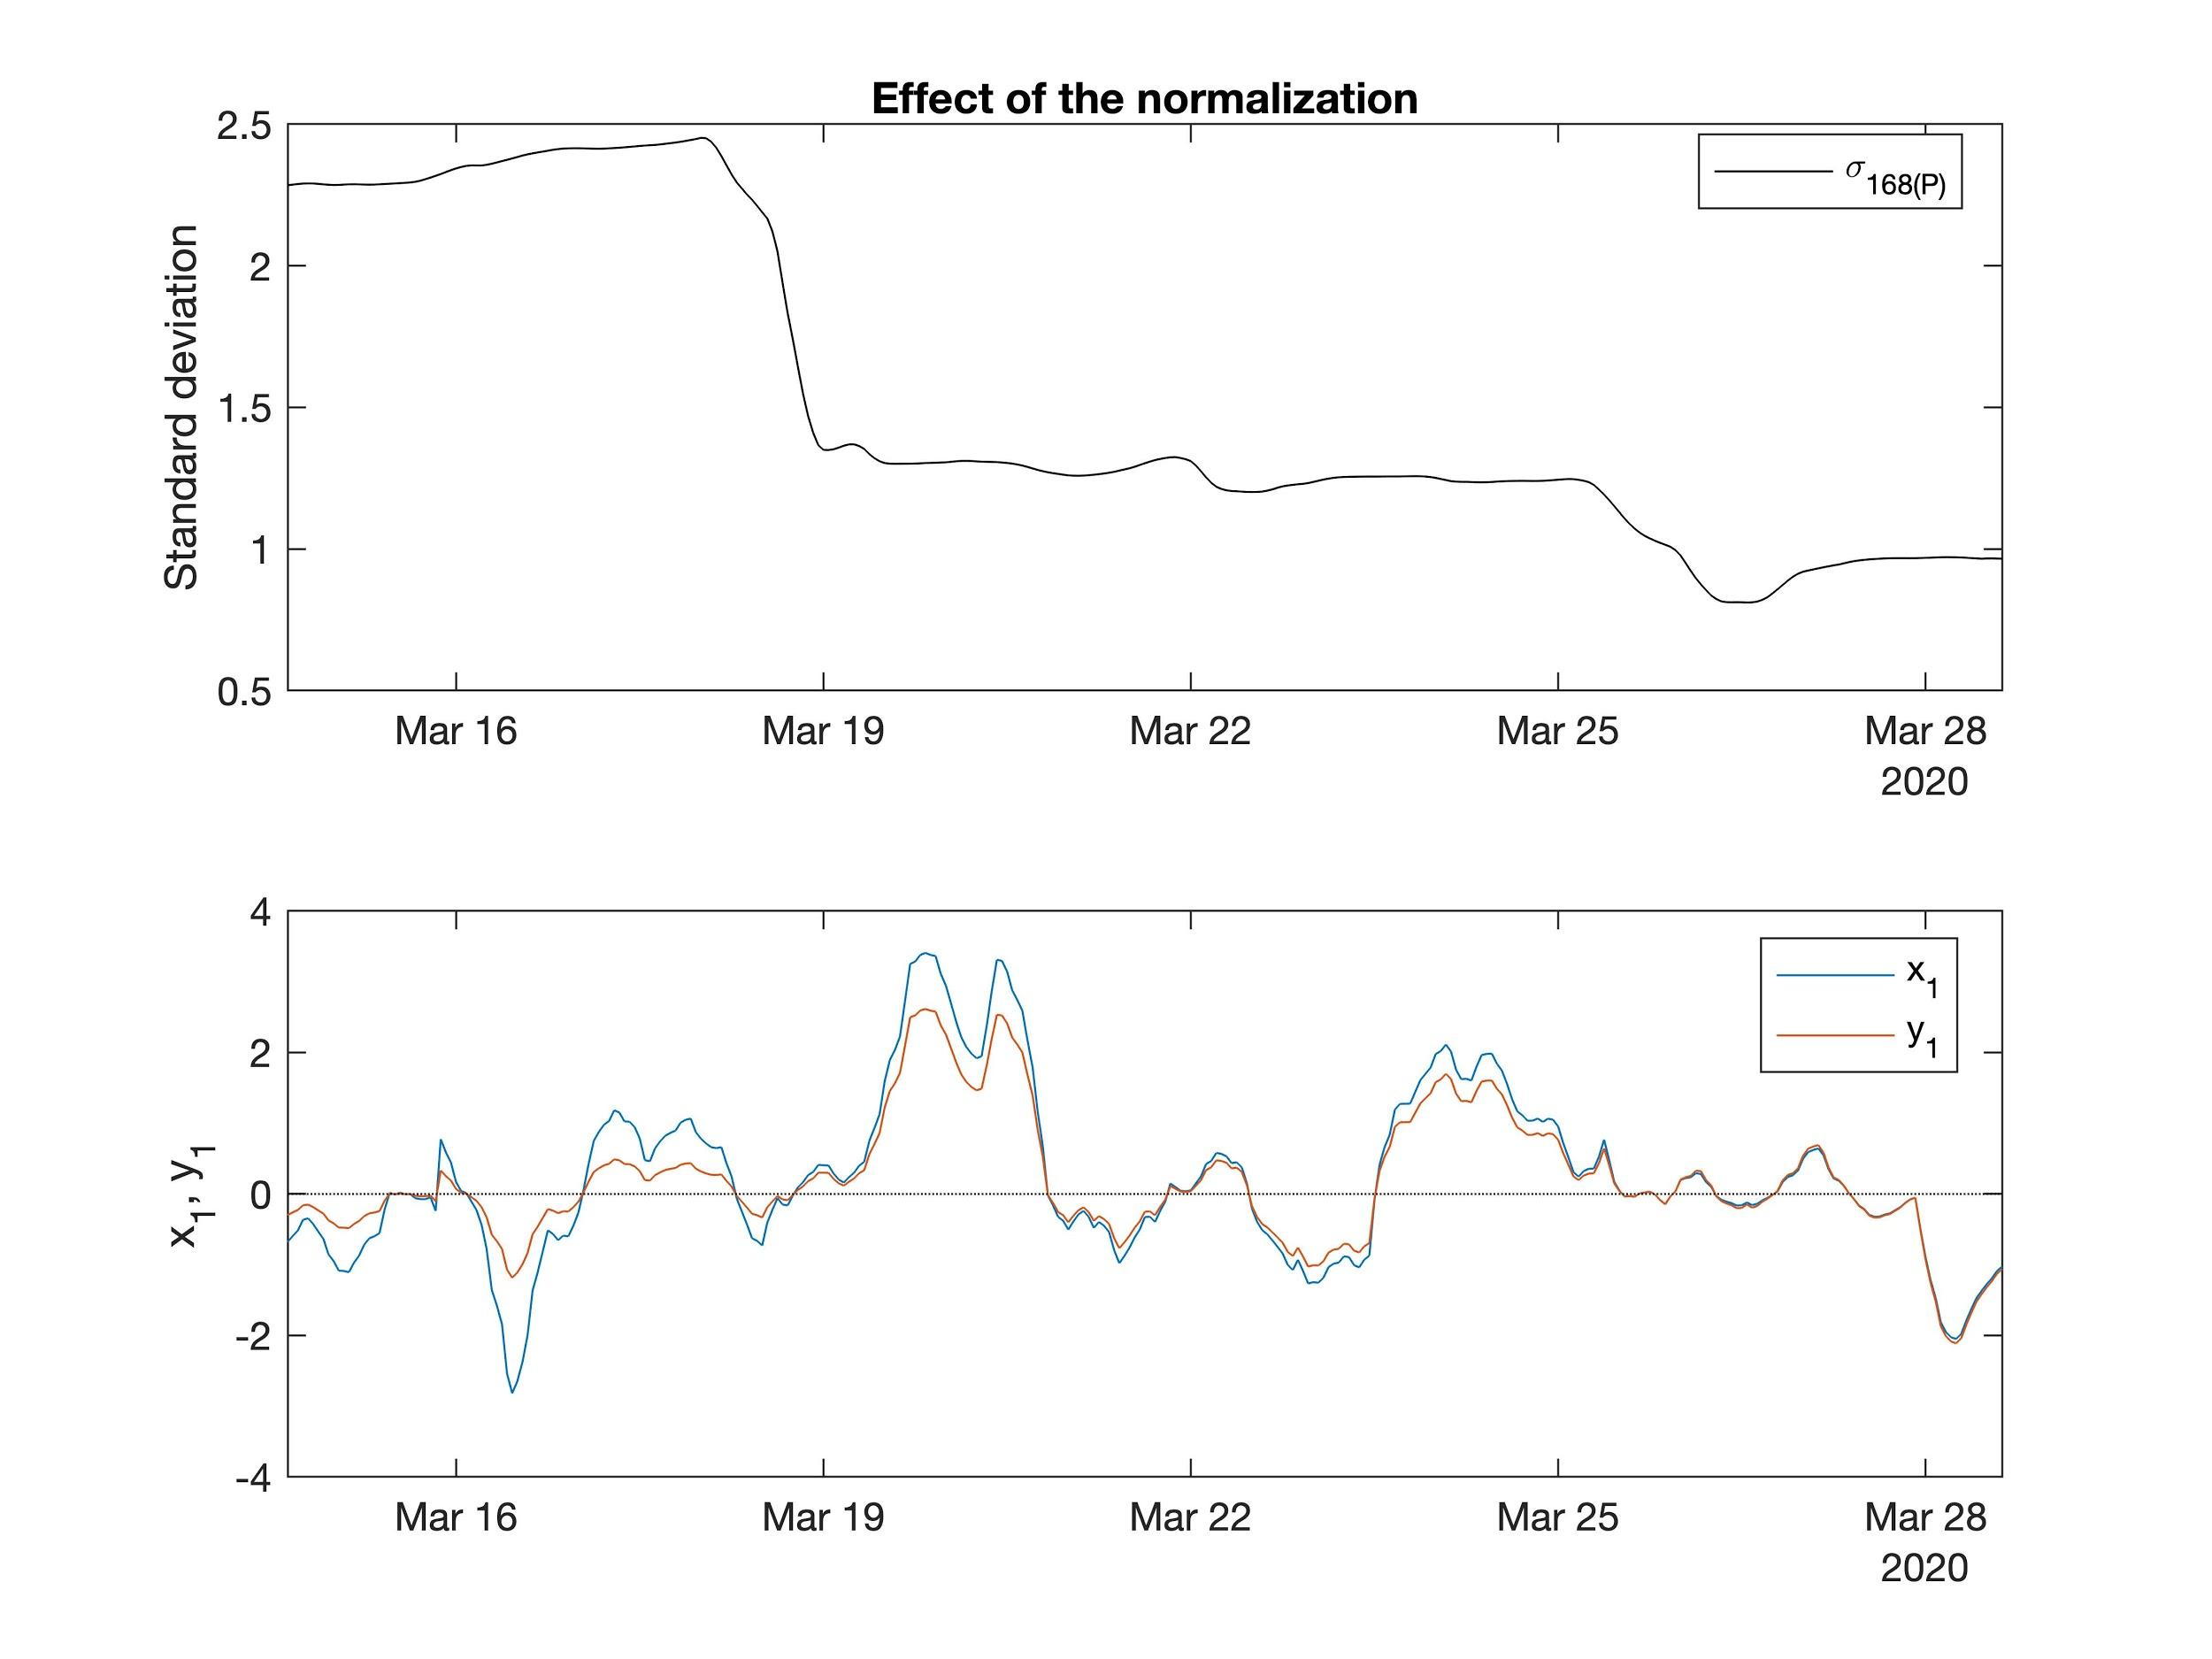
Two-step Normalization
Image 8: Effect of Normalization

Slide 15
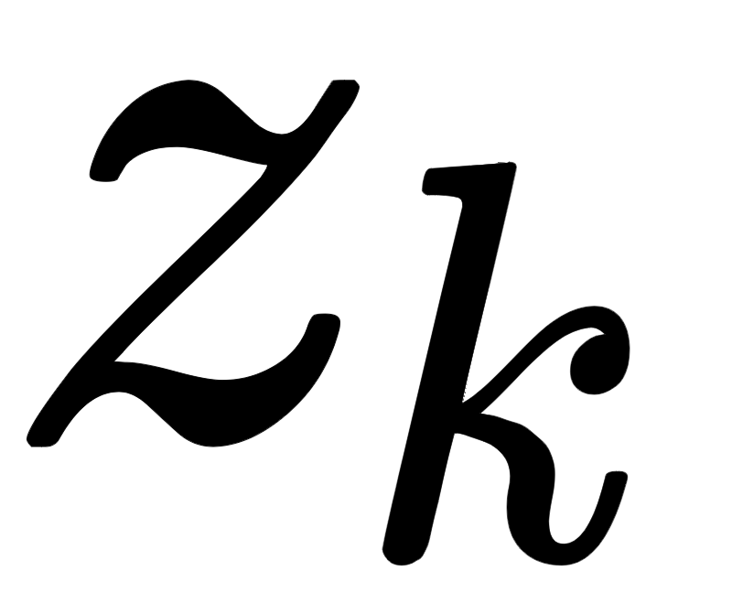
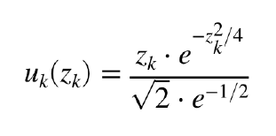
Generate signal
To scale between -1 and 1, we use response function proposed by Rohrbach et al. (2017), which used geometric Brownian Motion.

Slide 16
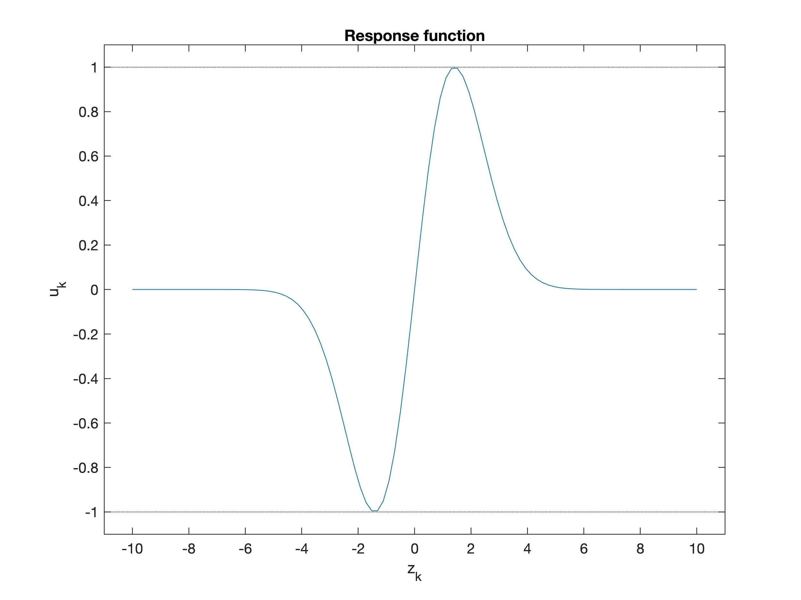
Generate signal
Image 9: Response Function

Slide 17
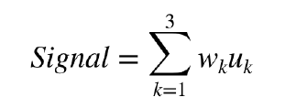

Generate signal
Final signal is calculated as:
with equal weighted = 1/3.

Slide 18
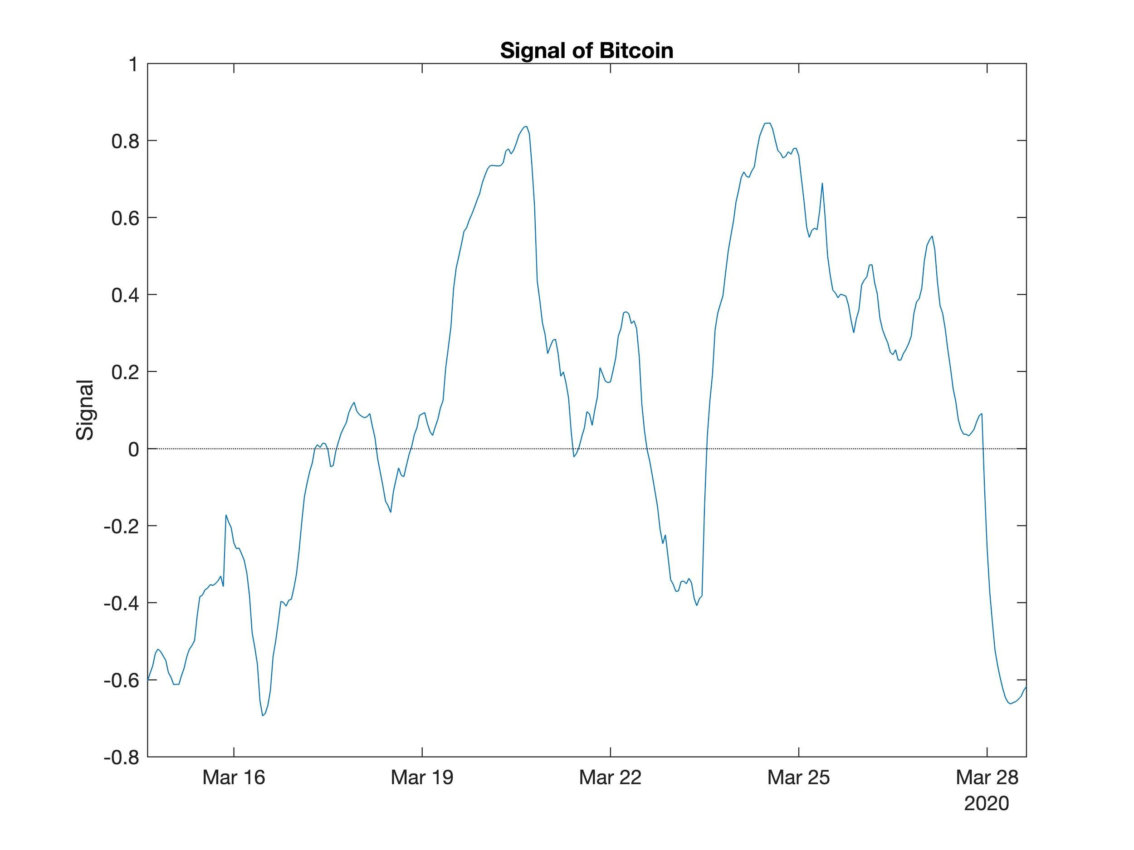
Generate signal
Image 10: Signal of Bitcoin

Slide 19
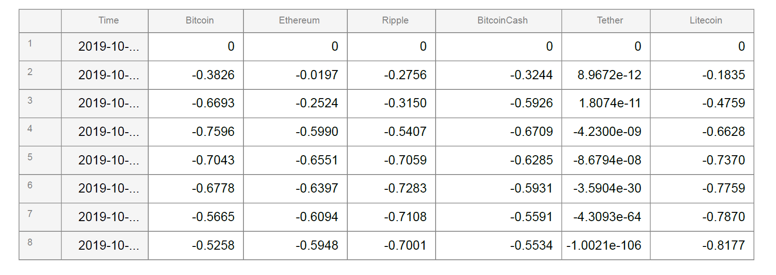
Create signal for all cryptos
Form 1: Signal for all cryptos

Slide 20
Portfolio Types

Slide 21
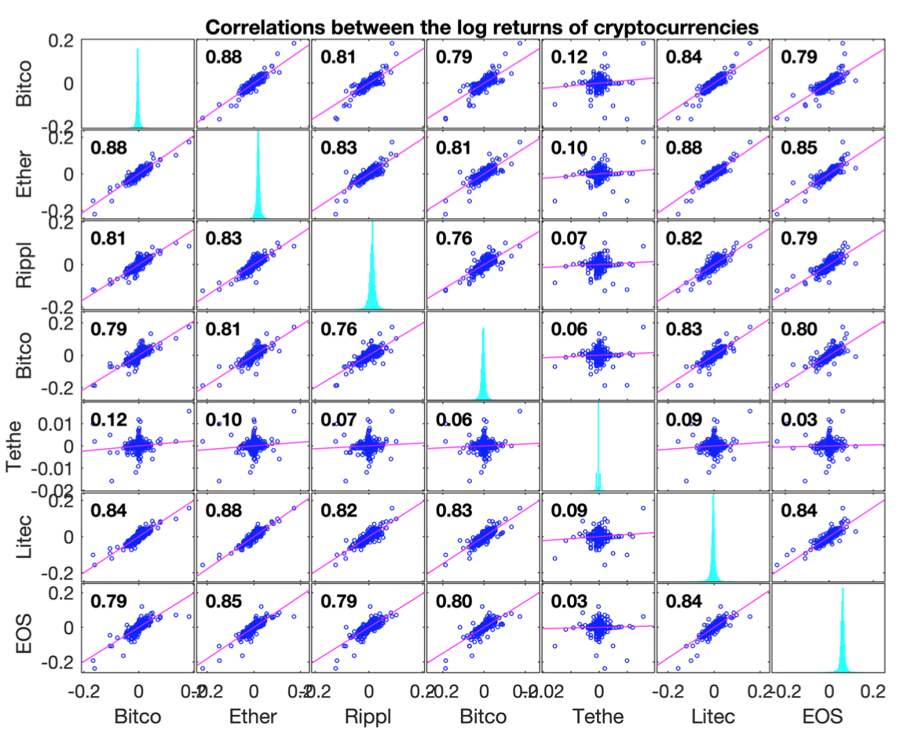
Correlations
Only Tether has weak correlation with other cryptos' returns.
Image 11: Correlations between the log returns of cryptocurrencies

Slide 22
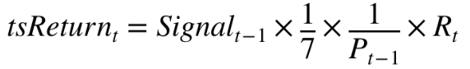
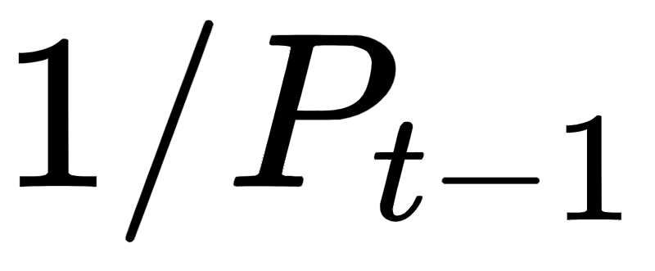
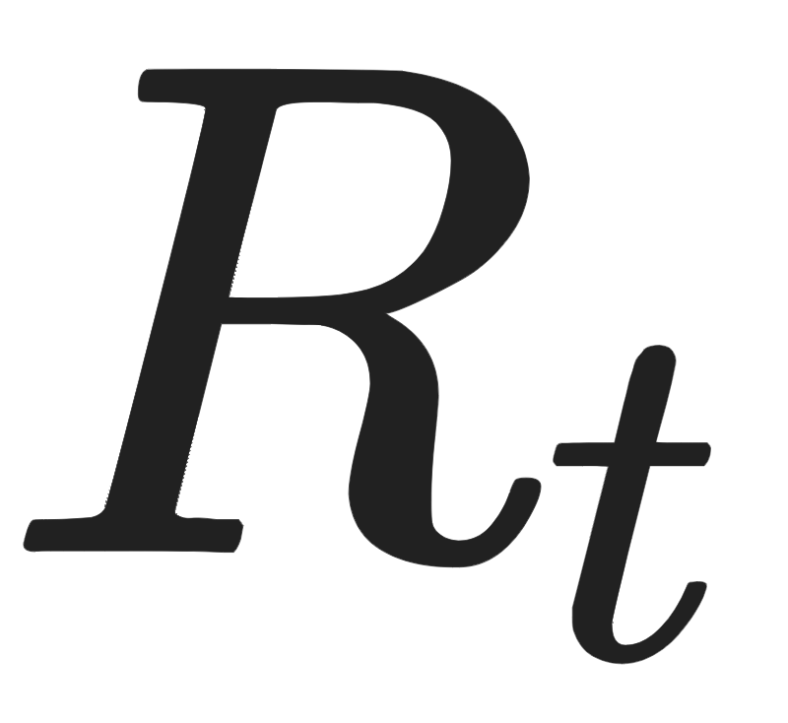
Times series port
Rebalancing every hour: buy (or sell) 1/n of the signal units of US dollars for a cryptocurrency, n=7.
where coincide with the indexed exchange rate of USD/crypto at signal period, is the log return of indexed price at time t.

Slide 23
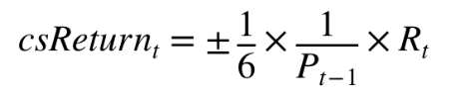
Cross-sectional port
Each hour, we long the three cryptocurrencies with the largest signals, and short three with the most negative signals.
These 6 trades are equally weighted in USD.

Slide 24
Benchmark
Equally weighted investment.
riskFreeRate = 0.01/252;
managementFeeRate = 0.01/252

Slide 25
Performance Analysis

Slide 26
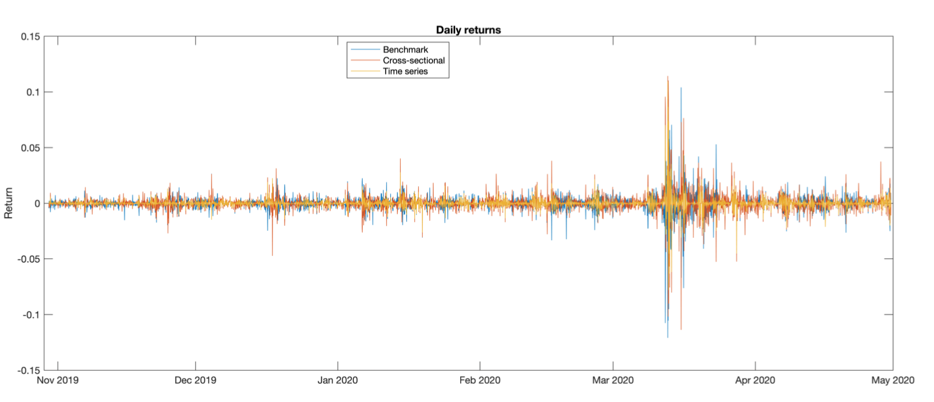
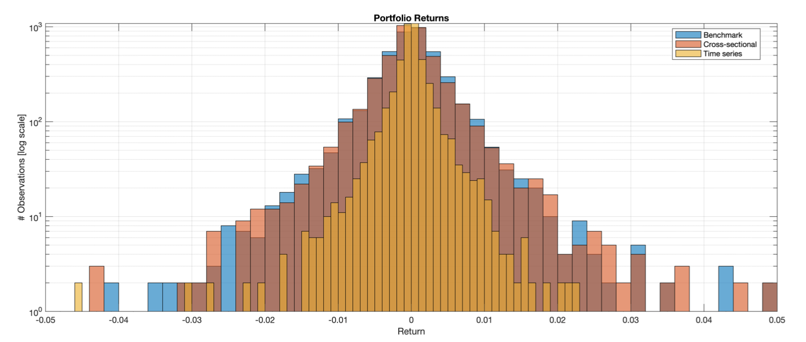
Returns

Slide 27
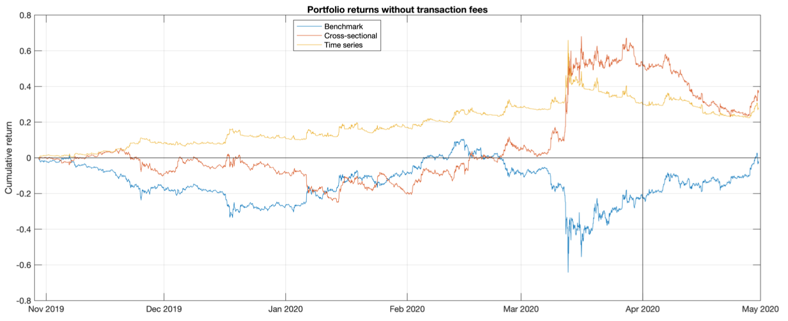
Equity
Cross-sectional portfolio obtained highest cumulative return before April 2020.
Image 13: Portfolio returns

Slide 28
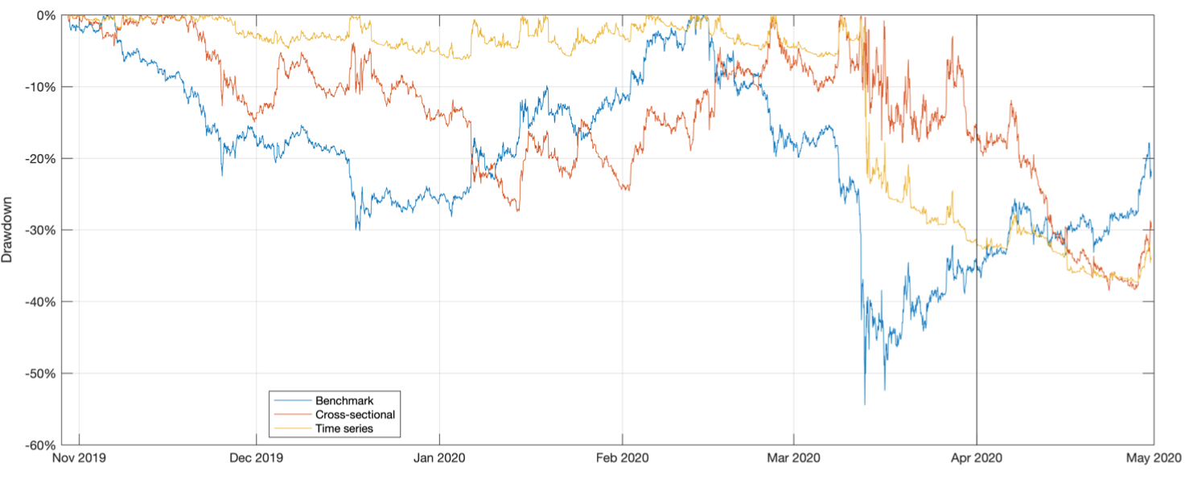
Drawdowns
Image 14: Portfolio drawdowns

Slide 29
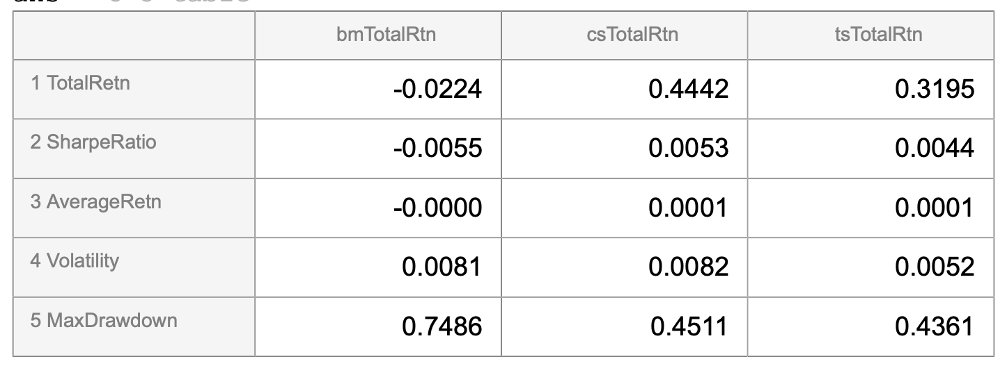
Performance Summary
Form 2: performance

Slide 30
Discussion

Slide 31
Discussion
Strengths:
Cross-sectional portfolio has the highest Sharpe ratio.
Time series portfolio performs better when not in crisis.
Weakness:
No single strategy beats others the whole time.
Long term Sharpe ratios are small.
Asset selection is fixed.

Slide 32
Future work
Data: Use TAQ data.
Model: Determine the mechanics set two strategies apart during crisis.
Backtesting: Take more specific transaction cost and market impact into account.

Slide 33
References
Chu J, Chan S, Zhang Y. (2020) High frequency momentum trading with cryptocurrencies. Research in international business and finance. 52:101176.
Rohrbach, Janick and Suremann, Silvan and Osterrieder, Joerg (2017) Momentum and Trend Following Trading Strategies for Currencies and Bitcoin. Combining Academia and Industry.
P. S. Lintilhac & A. Tourin (2017) Model-based pairs trading in the bitcoin markets. Quantitative Finance. 17:5, 703-716.
Platanakis, Emmanouil & Urquhart, Andrew (2019) Portfolio management with cryptocurrencies: The role of estimation risk. Economics Letters. ISSN: 0165-1765, Volume 177, p. 76.

